Slide 1
Vanishing Point Guided Network for Lane and Road Marking Detection and Recognition
(VPGNet)
By- Devyash Parihar

Slide 2
Contents
Introduction
Dataset used
VPGNet and its architecture
Training
Results
Challenges faced

Slide 3
Introduction
Autonomous driving is a large system that consists of various sensors and control modules.
The first key step for robust autonomous driving is to recognize and understand the environment around a subject.
However, simple recognition of obstacles and understanding of geometry around a vehicle is insufficient.
There are traffic regulations dictated by traffic symbols such as lane and road markings that should be complied with.

Slide 4
Dataset used (by authors):
They built up a lane and road marking detection and recognition benchmark dataset taken under various weather and illumination conditions.
The dataset consists of about 20,000 images with 17 manually annotated lane and road marking classes.
Vanishing point annotation is provided as well.

Slide 5
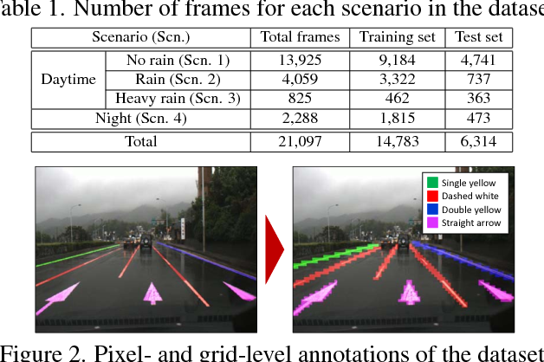
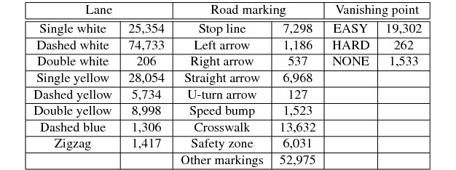

Slide 6
Caltech Lanes Dataset:
Caltech Lanes dataset includes four clips taken around streets in Pasadena, CA at different times of day.
The dataset is divided into four individual clips:
cordova1 with 250 frames
cordova2 with 406 frames
washington1 with 337 frames
washington2 with 232 frames

Slide 7
VPGNet and its architecture
A unified end-to-end trainable multi-task network that jointly handles lane and road markings detection and recognition. (guided by vanishing point)
In this paper, “Vanishing Point (VP)” is defined as the nearest point on the horizon where lanes converge and disappear predictively around the farthest point of the visible lane.
This VP can be used to provide a global geometric context of a scene, which is important to infer the location of lanes and road markings.

Slide 8
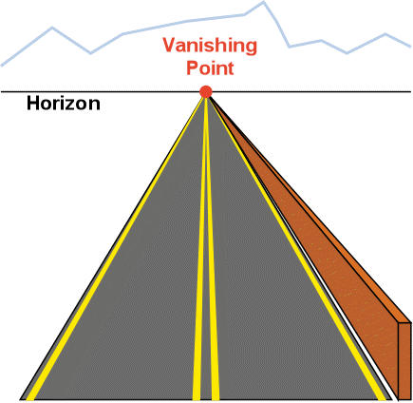
Vanishing point

Slide 9
Modules:
The network has four task modules and each task performs complementary cooperation:
Grid box regression
Object detection
Multi-label classification
Prediction of the vanishing point

Slide 10
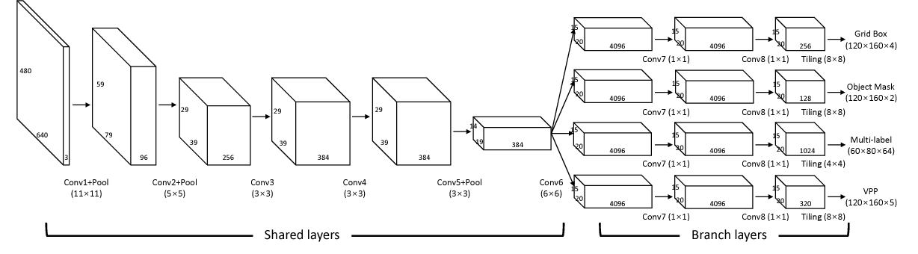

Slide 11
For post processing, lane classes only use the output of the multi-label task, and road marking classes utilizes both grid box regression and multi-label task.
The network has four task modules and each task performs complementary cooperation: grid box regression, object detection, multi-label classification, and prediction of the vanishing point.
This structure allows us to detect and classify the lane and road markings, and predict the vanishing region simultaneously in a single forward pass.

Slide 12
Training:
I used caffe framework to train and test VPGNet.
Deep Learning frameworks comparison: https://www.youtube.com/watch?v=MDP9FfsNx60

Slide 13
Training parameters:
test_iter = 20
test_interval = 100
base_lr = 0.005
lr_policy = step
gamma = 0.1
max_iter = 10,000
momentum = 0.9
solver_mode = GPU
Video for momentum: https://www.youtube.com/watch?v=k8fTYJPd3_I&t=350s

Slide 14
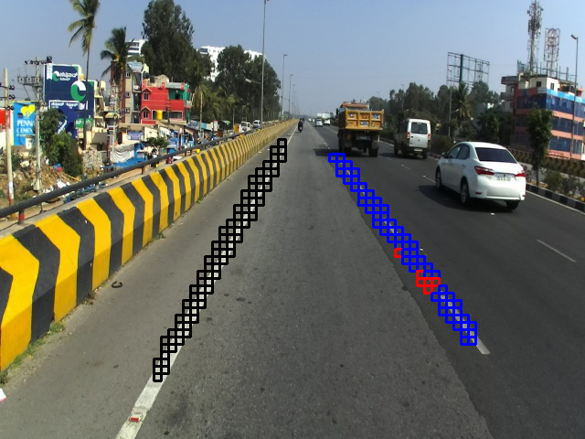
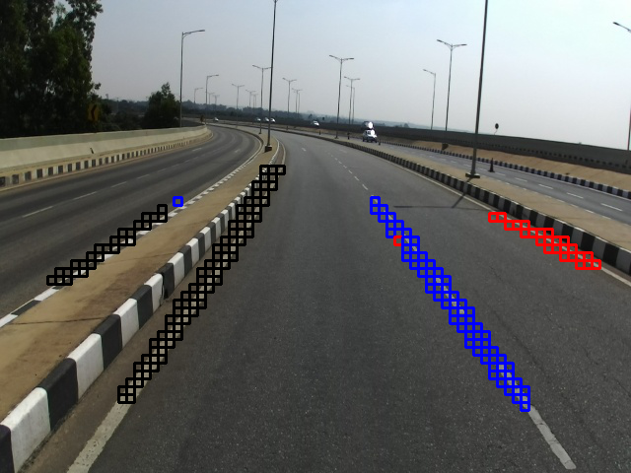
Results(On GAZE images):

Slide 15
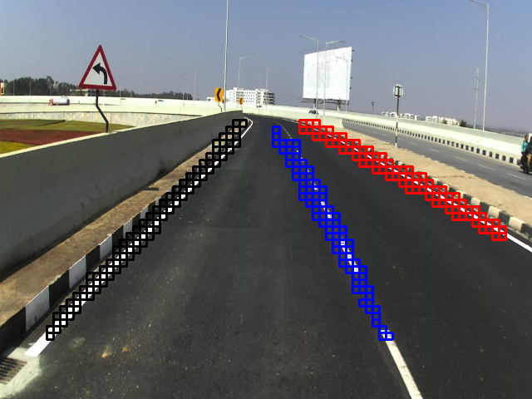
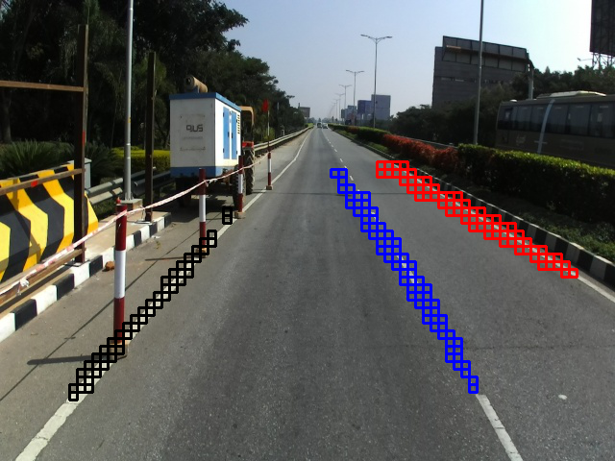
Results(On GAZE images):

Slide 16
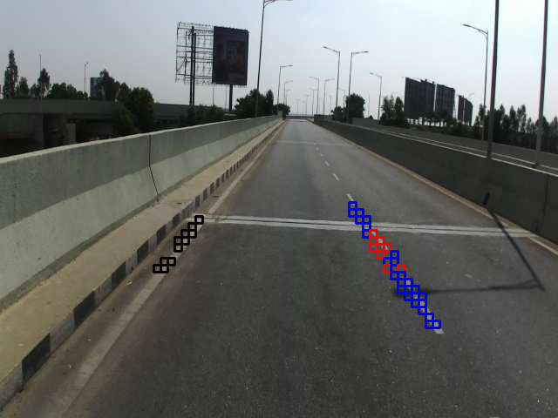
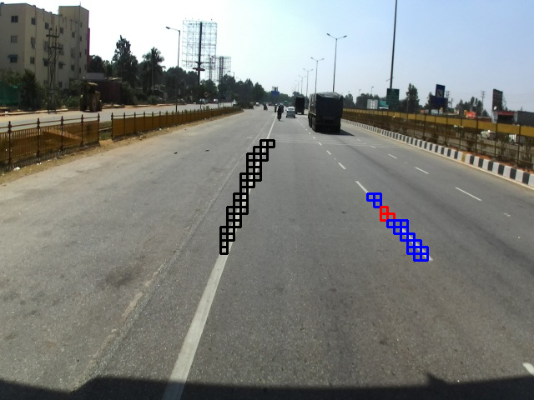
Results(On GAZE images):

Slide 17
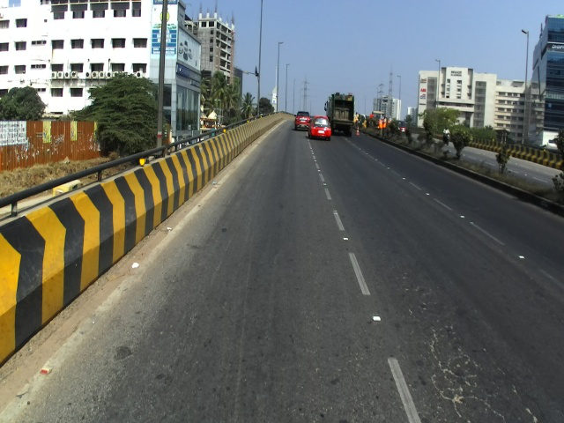
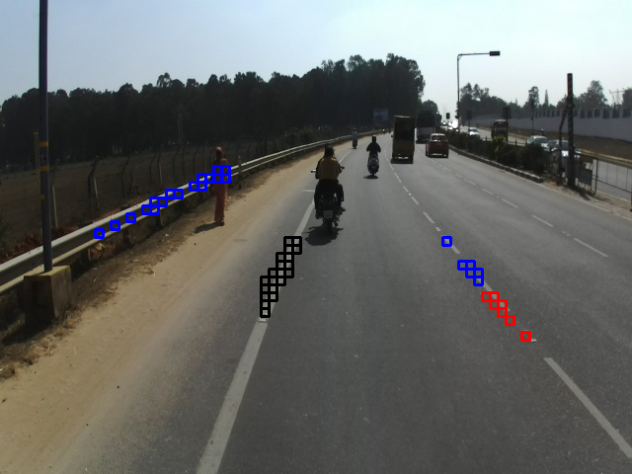
Results(On GAZE images):

Slide 18
Comparison with LaneNet on GAZE images

Slide 19
Challenges faced:
Post processing related codes/scripts are not available yet in the official github repository.
The dataset the paper claims to use has not been released yet.
There are no instructions or methods provided by authors on how to annotate the vanishing point in the images.
The dataset I used i.e. Caltech Lanes dataset, is quite small in comparison to the standard datasets like TuSimple, CULane, etc and does not have any annotation for vanishing point and road markings.
Data Augmentation: https://www.youtube.com/watch?v=rfM4DaLTkMs

Slide 20
Thank you

